Slide 1



BRIGHT COFFEE SHOP ANALYSIS
BCS, INC
Presented By Tshegofatso Mapheto
31 MARCH, 2026

Slide 2
CONTENT
BCS, INC.
Origins
Introduction
Data Systems
Analysis
Recommendation
Implementation Plan
Q&A

Slide 3

BCS, INC.
INTRODUCTION
This is a presentation made for the Bright Coffee Shop. The presentation will include graph and analysis on the revenue received by the company at different stores and different times. Different representations of the report is made to understand the data better.

Slide 4
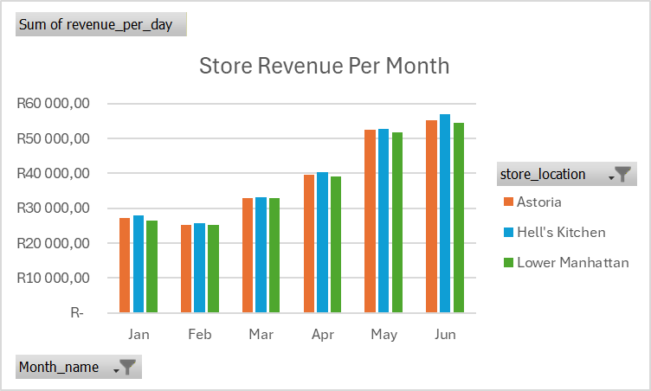
REVENUE ANALYSIS |STORE LOCATION & MONTH
BTC, INC.
Insights: Revenue across all the stores increase by 50% in the month of June as compared to January. This could be a seasonal change that influences sales.

Slide 5
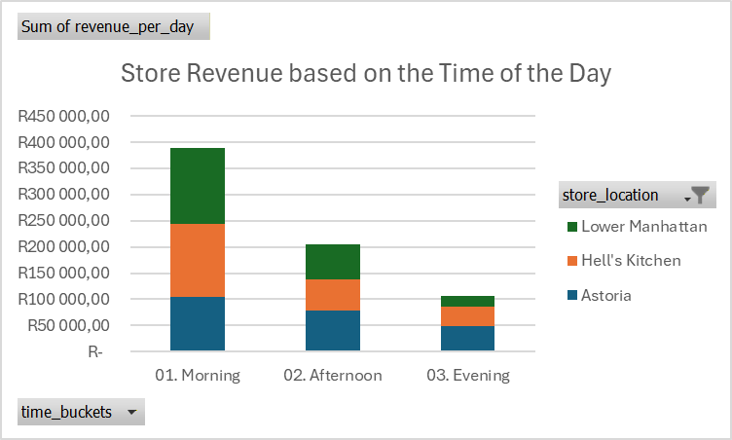
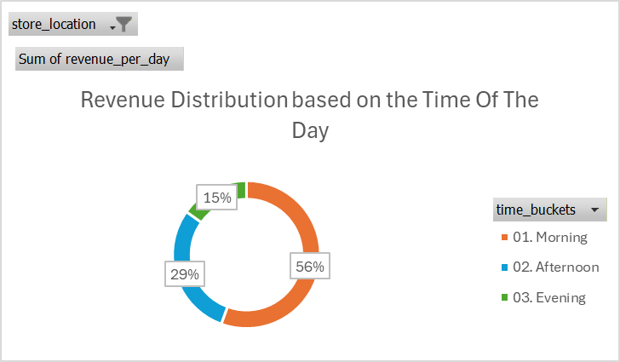

REVENUE ANALYSIS |STORE LOCATION & TIME OF THE DAY
BTC, INC.
Morning Slaes contributes 56% of the sales followed by afternoon which contributes 30% of the sales, however the evening contributes the lowest sales

